Slide 1
Age- and Dementia-Friendly Winnemucca and Humboldt County
Presented by the Age- and Dementia-friendly project team

Slide 2
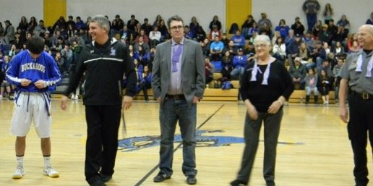
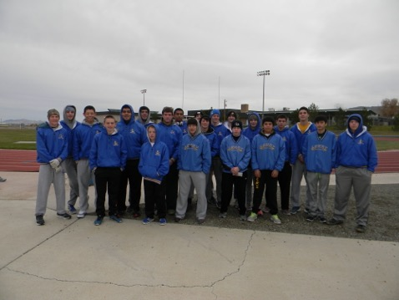
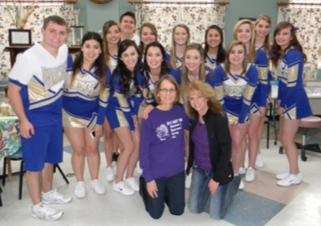
How it all began…

Slide 3
And then it grew…
Alzheimer’s Awareness events
Dementia and Driving Town Hall
Age-Friendly Winnemucca with WHO and AARP
Dementia-Friendly Nevada Project
Monthly meetings for 2+ years
Drive, desire, determination…

Slide 4
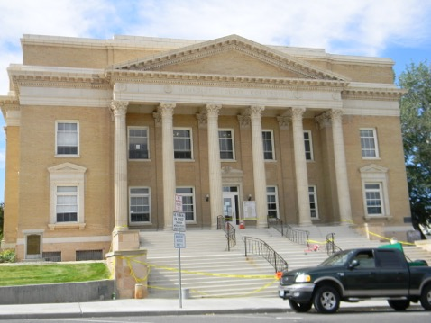
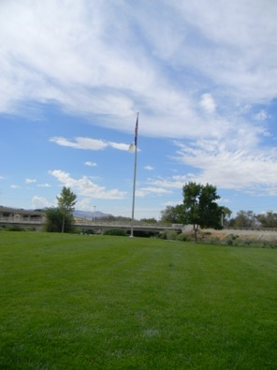
Outdoor Spaces and Buildings and Structures

Slide 5
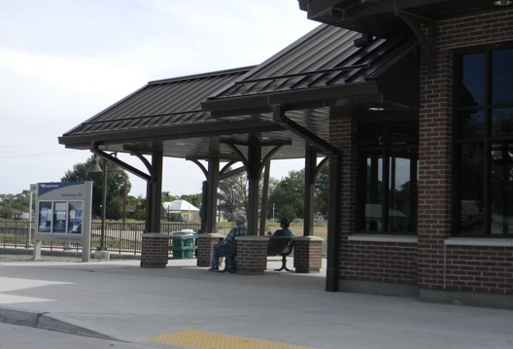
Transportation

Slide 6
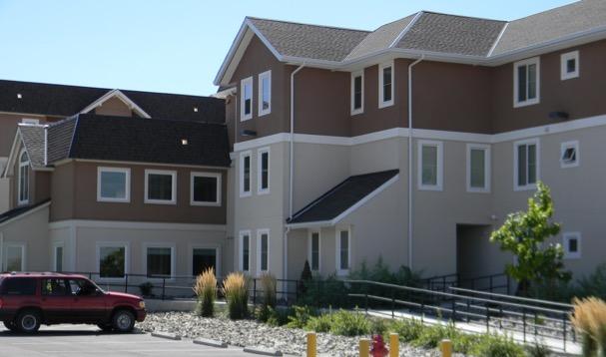
Housing

Slide 7
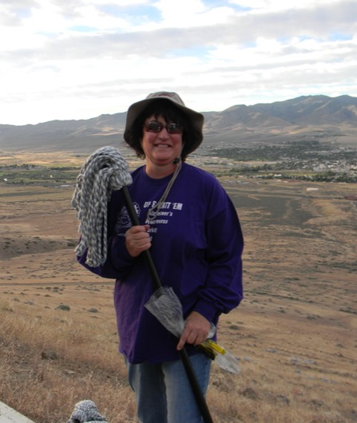
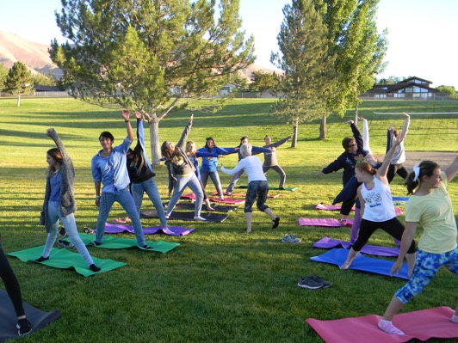
Social Participation

Slide 8
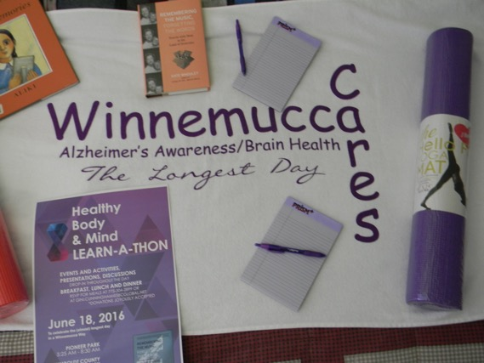
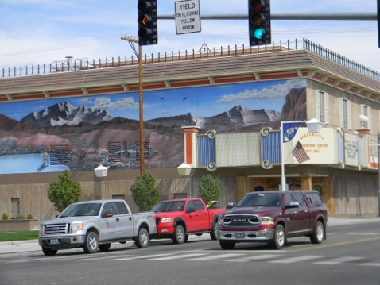
Civic Participation and Social Inclusion

Slide 9
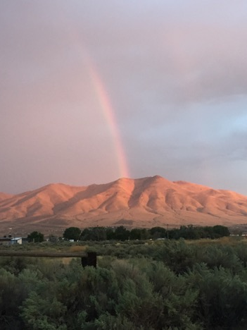
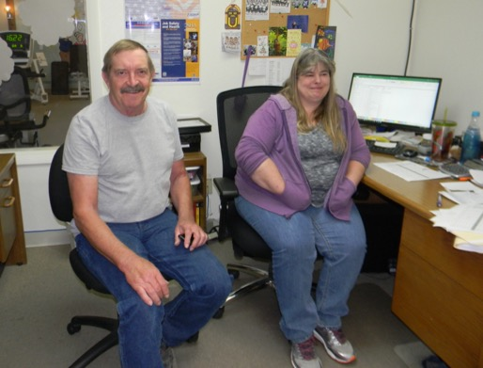
Communication and Information

Slide 10
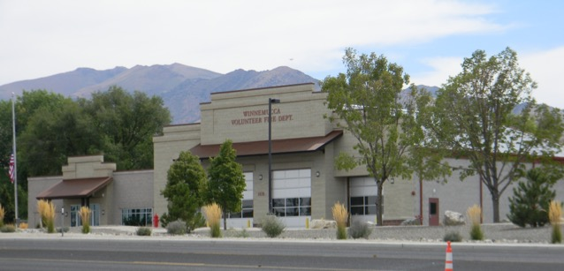
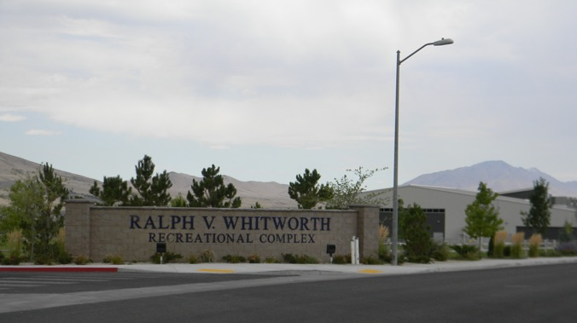
Community Support and Health Services

Slide 11
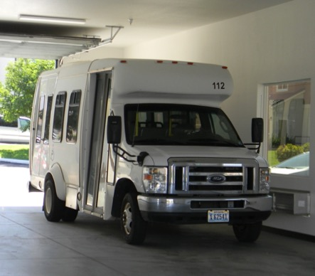
SMART Goals!
SMART Goal #1 – Senior bus stop for
downtown businesses – 4th and Bridge
SMART Goal #2 – Driver’s Education
Training for certified senior instructor for
Winnemucca
SMART Goal #3 – Concierge Service of Pleasant Center Senior bus

Slide 12
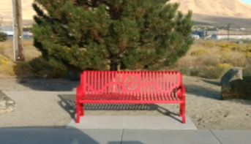
And then we sent out Survey #1 – Outdoor Spaces and Buildings/Structure
SMART Goal #4 – Benches and game tables
SMART Goal #5 – Walking, biking, and jogging trails marked and in good condition
SMART Goal #6 – Education and Awareness Campaign

Slide 13
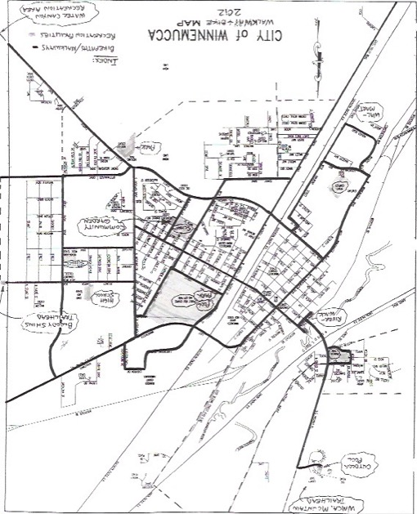
And then…
SMART Goal #7 – Public
restrooms/family restrooms
SMART Goal #8 – Map of
Winnemucca located at key
downtown locations
SMART Goal #9 – Additional flag
crossing(s)

Slide 14
And further more from Survey #2…
SMART Goal #10 – Wider advertisement of available transportation
SMART Goal #11 – Wider advertisement for leaf and snow removal
SMART Goal #12 – List for contractors of desired home features of seniors
Single story
If multiple storied have bathrooms, bedrooms, and laundry on main floor with kitchen and living/great room
Build accessible homes that include:
  Wide doorways and hallways
  Easy entryways with no steps or just 1-2
  Entries where ramps can be installed later as needed
  Modest, 2-3 bedroom
  Walk-in showers and/or tubs
  Security systems installed
  Bathrooms with access improvements such as handrails
  “Pod-like” communities where seniors can live close to one another in low-maintenance homes that also have grass/flower areas; independent but not high maintenance
  Homes with lever handles for easy access
  High efficiency homes to lower monthly bills

Slide 15
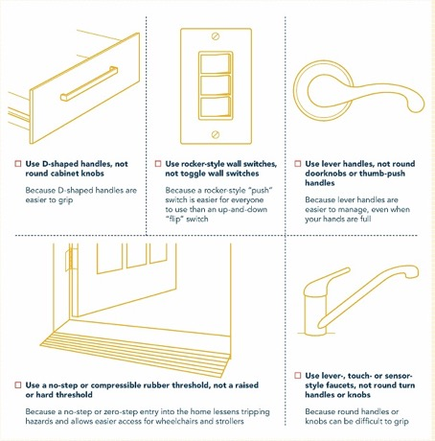
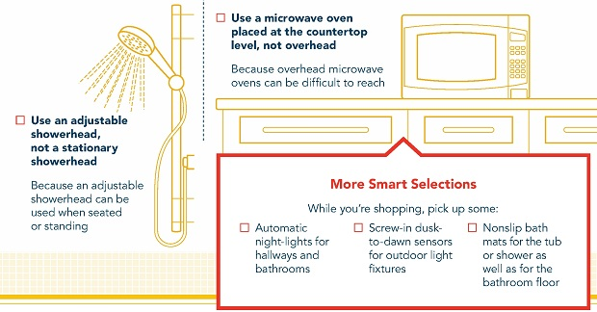
SMART Goal #13 – Create HomeFit flyer to distribute at our Education & Awareness Campaign

Slide 16
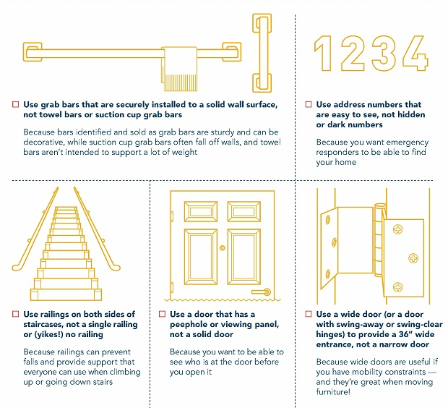

Slide 17
And to keep everyone informed…
SMART Goal #14 – Increased community awareness of our goals and endeavors through an Age-Friendly and Dementia-Friendly website
www.lovedignityalzheimers.net

Slide 18
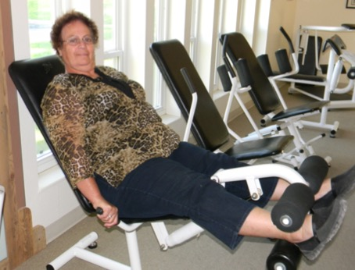
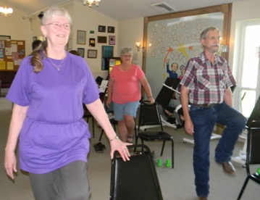
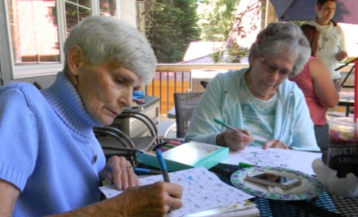
What would you like to see included?
To facilitate?
SMART Goal #15 – Expand social activities available to seniors including a walking club, bridge club, book club, and more…

Slide 19
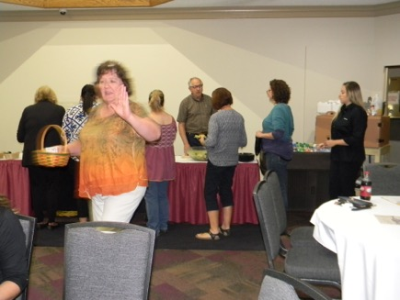
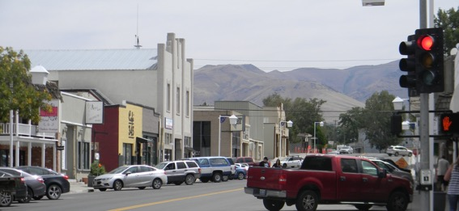
And from our dementia-friendly conversations…
SMART Goal #16 – Provide a business owner and employee training to offer knowledge and ideas for assuring the safety and independence of seniors as they age-in-place with a special emphasis on those with Alzheimer’s and other dementias.

Slide 20
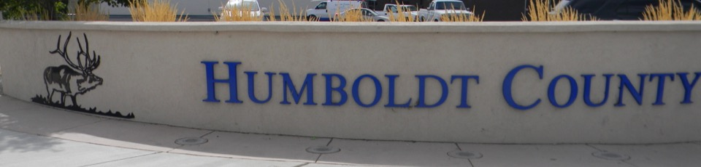
SMART Goal #17 - Booklet and brochures published for local residents to include main services available, information on Alzheimer’s and other dementias, and HomeFit – the Winnemucca guide to ensuring housing is ideal for aging in place.

Slide 21
Please join us…
This afternoon from 1-3pm at HGH
October 16 - 5pm HGH
November 20 – 5pm HGH
December 11 – 5pm TBA
Contact me:
Gini Cunningham gini.cunningham@sbcglobal.net

